Slide 1
Object Oriented Data Structures
Searching
STL Vector
Sequential Search
Binary Search
Comparison Trees

Slide 2

Searching

Slide 3
The STL vector Template
template<class T> class vector {
public:
typedef T * iterator;
typedef T value_type;
// constructors
vector (unsigned int numberElements);
vector (unsigned int numberElements,
T initialValue);
vector (const vector & source);
vector ();

Slide 4
The STL vector template
// member functions
T back ();
iterator begin ();
int capacity ();
bool empty();
iterator end ();
T front ();
void pop_back ();
void push_back (T);
void reserve (unsigned int);
void resize (unsigned int);
int size ();

Slide 5
The STL vector template
// operators
T & operator [ ] (unsigned int);
protected: // data areas
unsigned int mySize;
unsigned int myCapacity
T * data;
};

Slide 6
template <class T>
class orderedVector public vector<T>
{
public:
// constructors
orderedVector : vector<T>(){}
orderedVector( orderedVector & v): vector<T>(v){}
// additional methods
T & operator [ ] (unsigned int index) const;
// protocol for searching
int count (T & value);
void find (T & value);
void insert (T & value);
void erase (T & value);
};

Slide 7
Declaring Template Types
To declare a value with a template type, a type is provided in angle brackets following the template class name.
vector<int> a(10);
vector<double> b(30);
vector<string> c(15, “xyz”);

Slide 8
Summary of STL Vector Operations
Constructors
vector<T> v; default
vector<T> v(int); init,size
vector<T> v(int, T); size,valu
vector<T> v(aVector); copy

Slide 9
Summary of STL Vector Operations
Element Access
v[i] subscript
v.front() first
v.back() last

Slide 10
Summary of STL Vector Operations
Insertion
v.push_back (T)
  push on to back of vector
v.insert(iterator, T)
  insert before iterator
v.swap(vector<T>)
  swap values with another vector

Slide 11
Summary of STL Vector Operations
Removal
v.pop_back
  pop from back of vector
v.erase(iterator)
  remove single element
v.erase(iterator, iterator)
  remove range of values

Slide 12
Summary of STL Vector Operations
Size
v.capacity () max
v.size () current
v.resize(unsigned, T)
v.reserve (unsigned)
v.empty ()

Slide 13
Summary of STL Vector Operations
vector<T>::iterator itr
  declare a new iterator
v.begin()
  starting iterator
v.end()
  ending iterator

Slide 14
Generic Algorithms
fill(iterator start, iterator stop, value)
copy (iterator start, iterator stop,
iterator destination)
max_element(iterator start, iterator stop)
min_element(iterator start, iterator stop)
reverse(iterator start, iterator stop)
count(iterator start, iterator stop,
target value, counter)

Slide 15
Generic Algorithms
count_if(iterator start, iterator stop,
unary fun, counter)
transform(iterator start, iterator stop,
iterator destination, unary)
find(iterator start, iterator stop, value)
find_if(iterator start, iterator stop,
unary function)
replace(iterator start, iterator stop,
target value, replacement value)

Slide 16
Generic Algorithms
replace_if(iterator start, iterator stop,
unary fun, replacement val)
sort(iterator start, iterator stop)
for_each(iterator start, iterator stop,
function)
iter_swap(iterator, iterator)

Slide 17
Generic Algorithms -sorted
merge(iterator s1, iterator e1,
iterator s2, iterator e2,
iterator destination)
inplace_merge(iterator start,
iterator center,
iterator stop)
binary_search(iterator start,
iterator stop, value)

Slide 18
Generic Algorithms - sorted
lower_bound(iterator start,
iterator stop, value)
upper_bound(iterator start,
iterator stop, value)

Slide 19
Application - Root Finding
The idea of binary search can also be used in different circumstances where the algorithm does not necessarily apply.
0
0
8

Slide 20
Application - Root Finding
The idea of binary search can also be used in different circumstances where the algorithm does not necessarily apply.
0
0
4
8

Slide 21
Application - Root Finding
The idea of binary search can also be used in different circumstances where the algorithm does not necessarily apply.
0
0
4
8

Slide 22
Application - Root Finding
The idea of binary search can also be used in different circumstances where the algorithm does not necessarily apply.
0
0
2
4
8

Slide 23
Application - Root Finding
The idea of binary search can also be used in different circumstances where the algorithm does not necessarily apply.
0
0
2
4
8

Slide 24
0
0
1
2

Slide 25
0
0
1
2

Slide 26
0
0
.5
1
2

Slide 27
0
0
.5
1
2

Slide 28
0
0
.5
1
2

Slide 29
Binary Search
0
1
2
3
4
5
6
7
8
9
10
11
4
8
11
23
35
45
55
62
67
78
89
92
For this algorithm to work, the data must be sorted in the array.

Slide 30
Binary Search
0
1
2
3
4
5
6
7
8
9
10
11
4
8
11
23
35
45
55
62
67
78
89
92
Suppose the item of interest has value 62!
The algorithm finds the midpoint of the array (0+11)/2 = 5 and looks in that position.
If the item is found, the search is over

Slide 31
Binary Search
0
1
2
3
4
5
6
7
8
9
10
11
4
8
11
23
35
45
55
62
67
78
89
92
In this case, the item wasn’t found. However, since the array is sorted and 62 > 45, we know it should be below the midpoint, if it exists.
We now look at the midpoint of what is left by calculating the index (6+11)/2 = 8, and look there.

Slide 32
Binary Search
0
1
2
3
4
5
6
7
8
9
10
11
4
8
11
23
35
45
55
62
67
78
89
92
If the item is found, the search is over.
In this case, the search goes on.

Slide 33
Binary Search
0
1
2
3
4
5
6
7
8
9
10
11
4
8
11
23
35
45
55
62
67
78
89
92
We know 62 < 67 so we should restrict our search to the portion above that has not been searched.
If we recalculate the search index (6+7)/2=6 we see that we are narrowing down on the location.

Slide 34
Binary Search
0
1
2
3
4
5
6
7
8
9
10
11
4
8
11
23
35
45
55
62
67
78
89
92
But, we are still not there.
There is really only one place left to look but the algorithm doesn’t know this. It only knows that 62>55 so it should look below the current location.

Slide 35
Binary Search
0
1
2
3
4
5
6
7
8
9
10
11
4
8
11
23
35
45
55
62
67
78
89
92
One final calculation of the index (7+7)/2 = 7 leads us to the location we have been looking for.
Note that we only repeated the process and comparison four times (looking in 5, 8, 6, 7) and that is pretty good when there are actually 11 cells.

Slide 36
A Simple but Subtle Idea
Although binary search is a simple and obvious idea, it is surprisingly easy to code incorrectly. You really need invariants to provide correctness.
Invariant:
low is the index of the smallest value that could possibly match the target.
high is the index of the first element that is definitely larger than target, or is one element larger than the size of the vector if all elements are smaller than target.
Algorithm proceeds by examining midpoint, and changing either low or high so as to preserve invariants.

Slide 37
STL Binary Search
bool binary_search(iterator start,
iterator stop, value);

Slide 38
    Error_code
    recursive_binary_1(const Ordered_list &the_list,
    const Key &target,int bottom, int top, int &position)
    {
    Record data;
    if (bottom < top) {// List has more than one entry.
    int mid = (bottom + top) / 2;
    the_list.retrieve(mid, data);
    if (data < target) // Reduce to top half of list.
    return recursive_binary_1(the_list, target,
    mid + 1, top, position);
    else // Reduce to bottom half of list.
    return recursive_binary_1(the_list, target,
    bottom, mid, position);
    }
    else if (top < bottom)
    return not_present; // List is empty.
    else { // List has exactly one entry.
    position = bottom;
    the_list.retrieve(bottom, data);
    if (data == target)
    return success;
    else
    return not_present;
    }
    }

Slide 39
    Error_code
    recursive_binary_2(const Ordered_list &the_list,
    const Key &target, int bottom, int top, int &position)
    {
    Record data;
    if (bottom <= top) {
    int mid = (bottom + top) / 2;
    the_list.retrieve(mid, data);
    if (data == target) {
    position = mid;
    return success;
    }
    else if (data < target)
    return recursive_binary_2(the_list, target,
    mid + 1, top, position);
    else
    return recursive_binary_2(the_list, target,
    bottom, mid - 1, position); }
    else
    return not_present;
    }

Slide 40
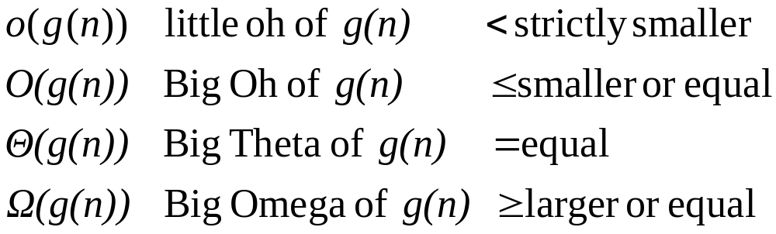
Order of Magnitude

Slide 41
Computer Times Used by Algorithms
n log n n nlog n n² 2^{n} n!
10 3E-9 E-8 3E-8 E-7 E-6 3E-3
10² 7E-9 E-7 7E-7 E-5 4E13yr *
10³ 1E-8 E-6 E-5 E-3 * *
10⁴ 1.3E-8 E-5 E-4 E-1 * *
10⁵ 1.7E-8 E-4 2E-3 10 * *
10⁶ 2E-8 E-3 2E-2 17min * *
All times are in seconds unless otherwise stated. An * indicates a time of more than 10¹⁰⁰ years.

Slide 42
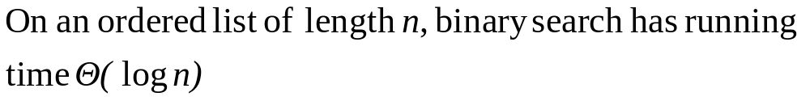
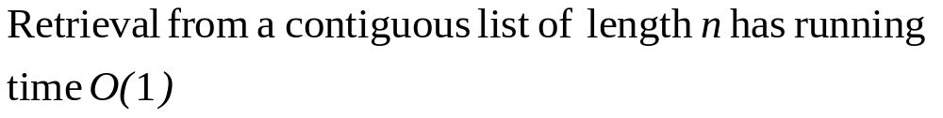
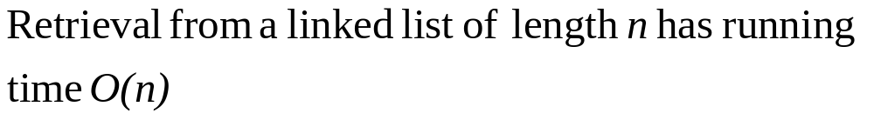
Order of Magnitude

Slide 43
class Key, Used for Comparisons
    class Key
    {
    int x;
    public:
    static int comparisons;
    Key(int x = 0);
    int the_key() const;
    };

Slide 44
class Key Comparison Operators
    // Declare overloaded comparison operators
    bool operator ==(const Key &x, const Key &y);
    bool operator > (const Key &x, const Key &y);
    bool operator < (const Key &x, const Key &y);
    bool operator >=(const Key &x, const Key &y);
    bool operator <=(const Key &x, const Key &y);
    bool operator !=(const Key &x, const Key &y);

Slide 45
Overloading Operators
    bool operator ==(const Key &x, const Key &y)
    {
    Key::comparisons++;
    return x.the_key() == y.the_key();
    }

Slide 46
    void test_search(int searches, List<Record> &the_list)
    {
    int list_size = the_list.size();
    if (searches <= 0 || list_size < 0) {
    cout << " Exiting test: " << endl
    << " The number of searches must be positive."
    << endl;
    << " The number of list entries must exceed 0."
    << endl;
    return;
    }
    int i, target, found_at;
    Key::comparisons = 0;
    Random number;
    Timer clock;
    for (i = 0; i < searches; i++) {
    target = 2 * number.random_integer(0, list_size - 1) + 1;
    if (sequential_search(the_list, target, found_at)
    == not_present)
    cout << "Error: Failed to find expected target "
    << target << endl;
    }

Slide 47
    print_out("Successful", clock.elapsed_time(),
    Key::comparisons, searches);
    Key::comparisons = 0;
    clock.reset();
    for (i = 0; i < searches; i++) {
    target = 2 * number.random_integer(0, list_size);
    if (sequential_search
    (the_list, target, found_at) == success)
    cout << "Error: Found unexpected target "
    << target << " at " << found_at << endl;
    }
    print_out("Unsuccessful", clock.elapsed_time(),
    Key::comparisons, searches);
    }

Slide 48

Chapter 7 Ends

